Slide 2
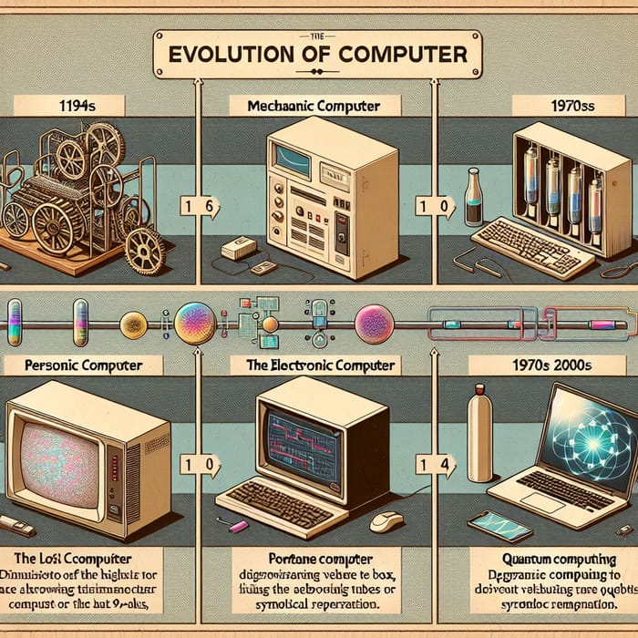
What is a computer?

Slide 3
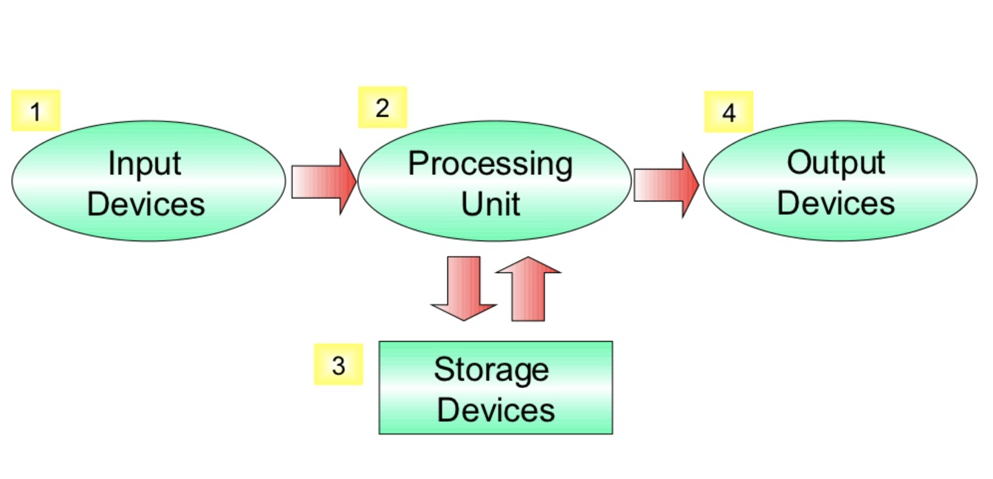
What is a computer?

Slide 4
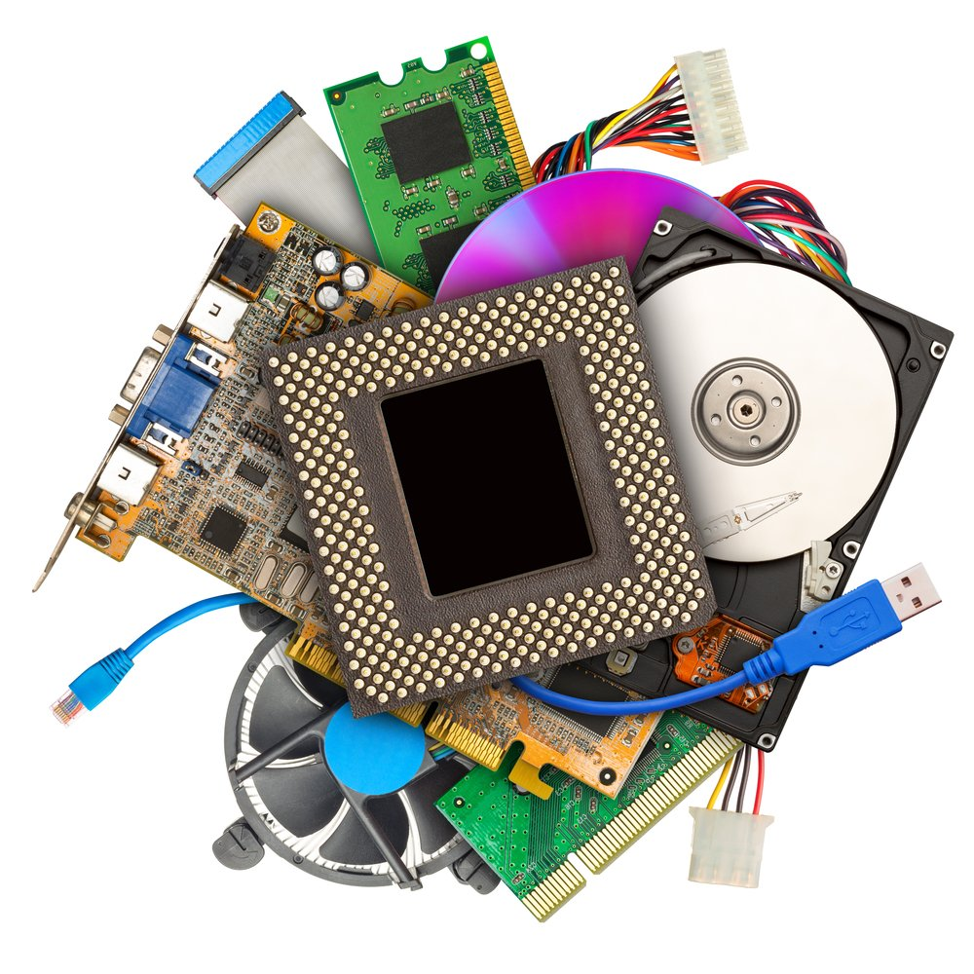
What are the components of a computer?

Slide 5
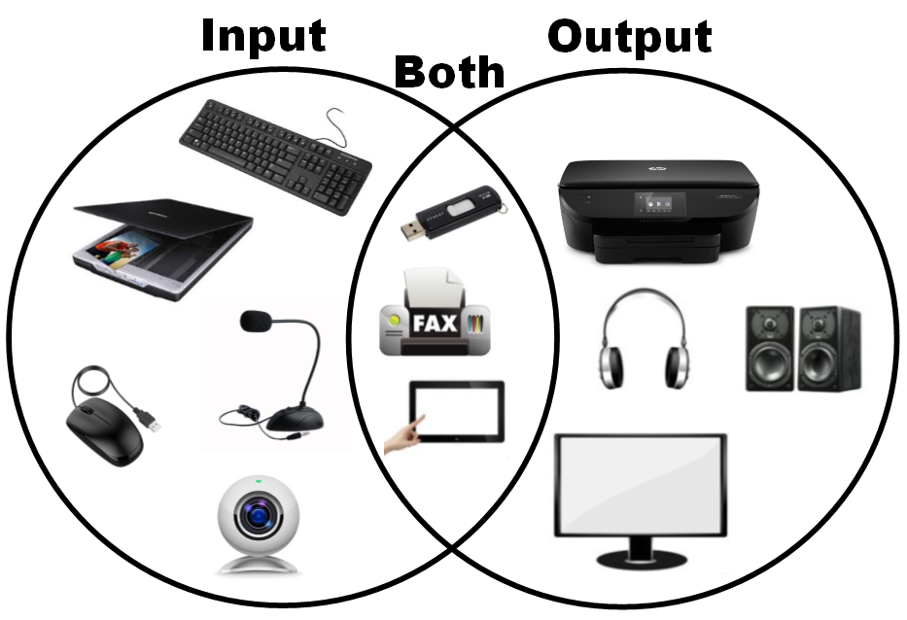

Slide 6
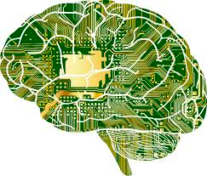
CENTRAL PROCESSING UNIT (CPU)

Slide 7
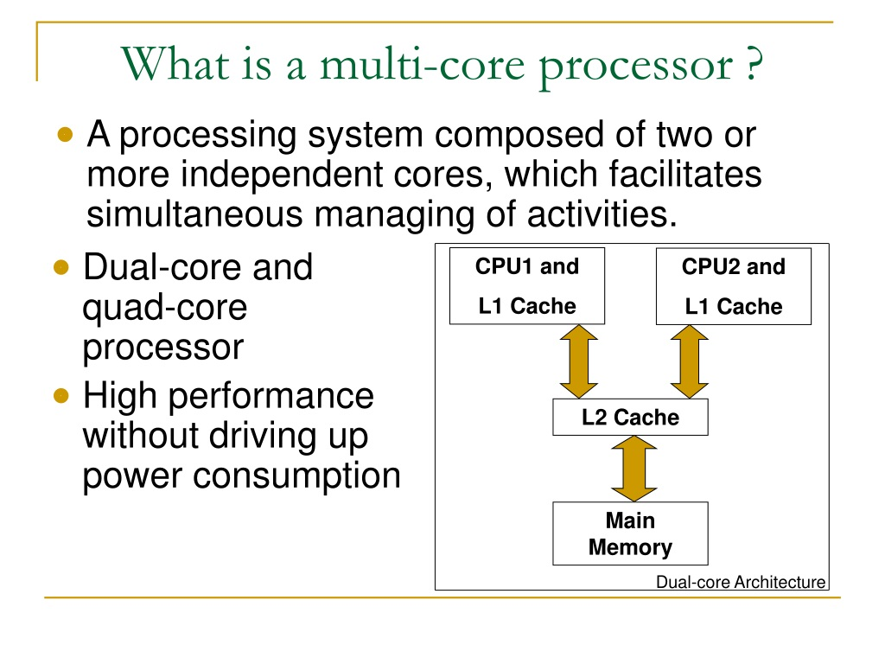

Slide 8
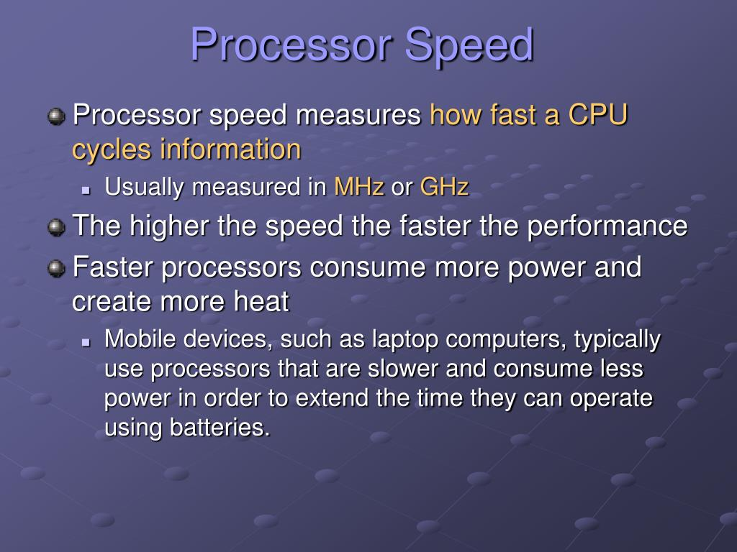

Slide 9
MOTHERBOARD

Slide 10
RAM

Slide 11
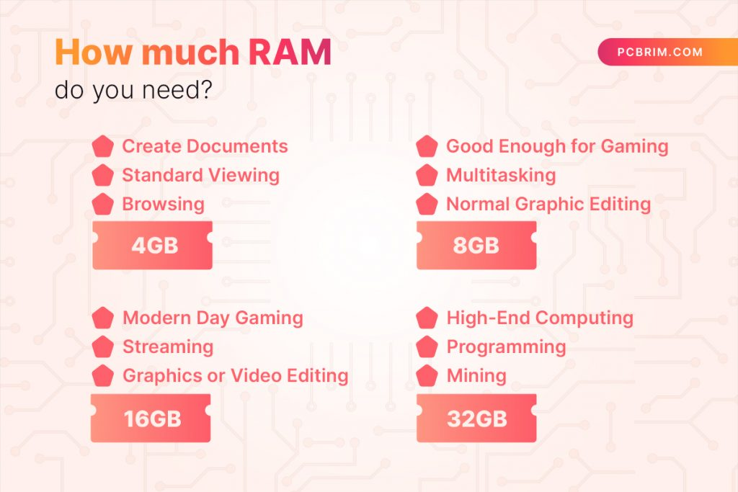

Slide 12
STORAGE
Measured in bytes (MB, GB)

Slide 13
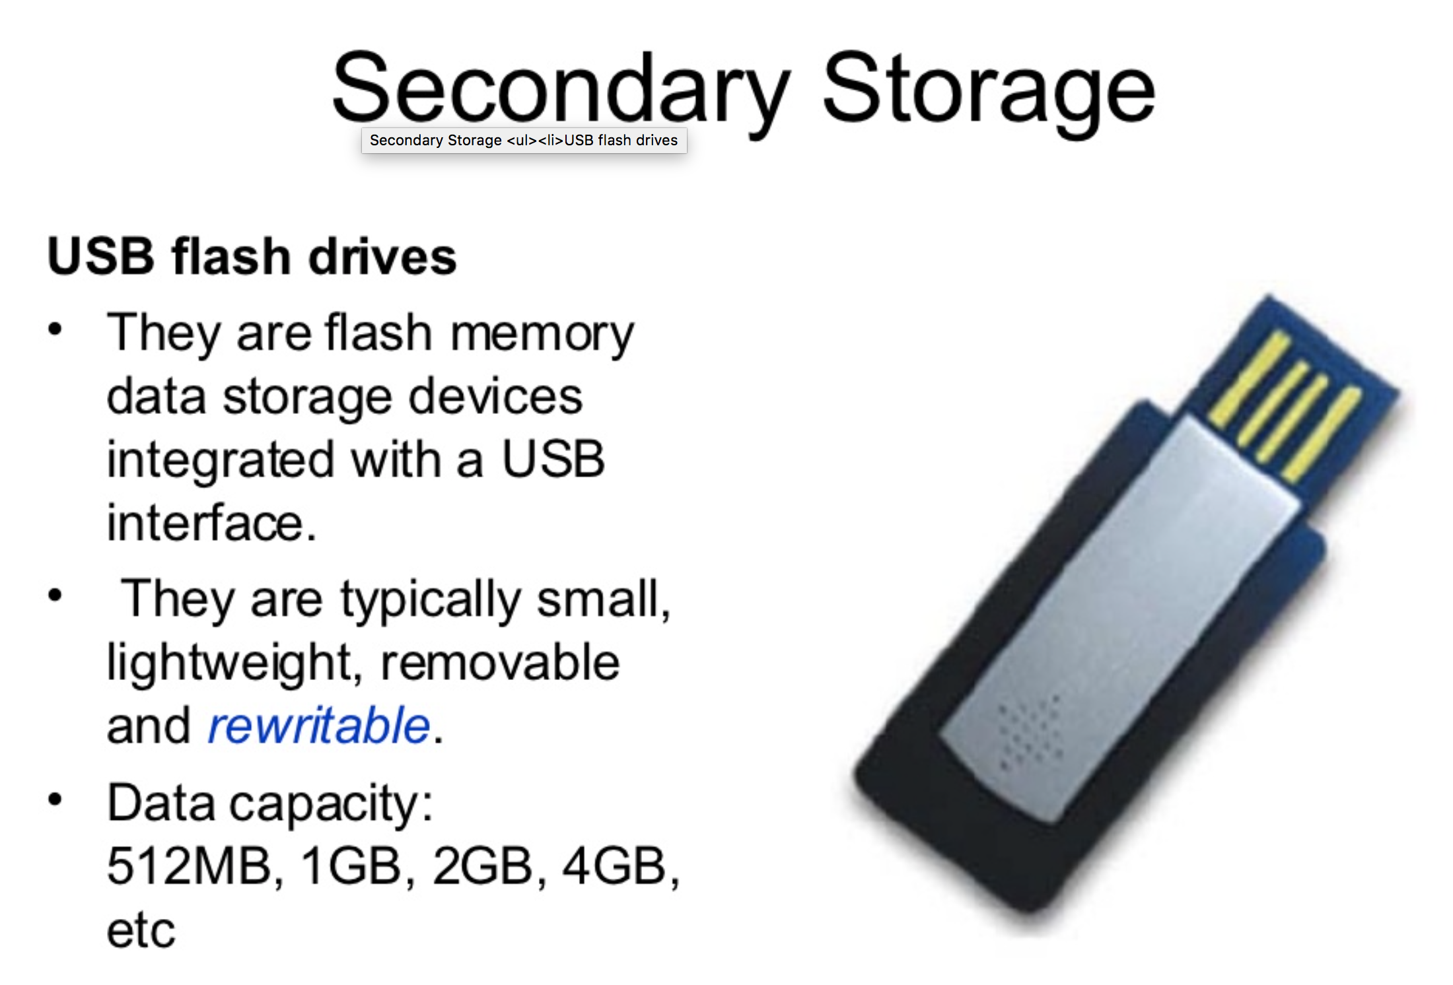

Slide 14
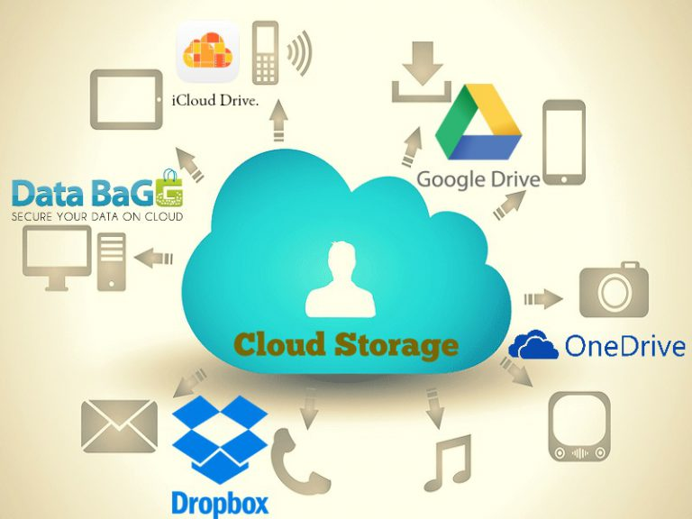

Slide 15
POWER SUPPLY
HEATSINK / FAN

Slide 16
EXPANSION CARDS

Slide 17
PORTS

